Slide 1

EMPLOYEE MANAGEMENT SYSTEM
BY
160117733032
160117733041

Slide 2
INDEX
ABSTRACT
EXISTING SYSTEM
DISADVANTAGES
PROPOSED SYSTEM
ADVANTAGES
MODULES

Slide 3
ABSTRACT
This software application stores all the employee’s information in a database. It is an application developed in C language. It contains employee information like name, employee id, age, position. Only the administrator has access rights to change or modify any records. The main aim of this application is to reduce the human errors made in the manual system. A search can be made to find out details about the employee using an employee id. It is easy to update any employee details.

Slide 4
EXISTING SYSTEM
The problem definition for designing the system is to maintain data of employee, to make easy controlling employees, to use technology for accurate and timely processing by fully privacy and full authority access. The objective of the project is to set up employee information system about status of employee and attendance of employee and monthly salary process and delivery. To eliminate or reduce as much as possible the hardships of existing system and avoid errors while entering data. In existing method employee management are employee record are maintain in records.

Slide 5
DISADVANTAGES
Needs for extra manual effort .
Existing system is a standalone process, normal employee cannot track their employee status .
Less Accuracy.
Time consuming process.

Slide 6
PROPOSED SYSTEM
This Employee management system is used for keeping the record of an employee in an organization such as school, college, universities, etc. Our project aims to design an employee management system which could effectively manage the information of employees at institutes, organisation, etc. This application maintains a database which has the details of the employees such as their name, unique id, image, designation, date of joining etc.

Slide 7
ADVANTAGES
Helps in maintaining the computerized employee details .
Can easily update employee details.
More Efficient and reliable.
Less time consuming and easy to use.

Slide 8

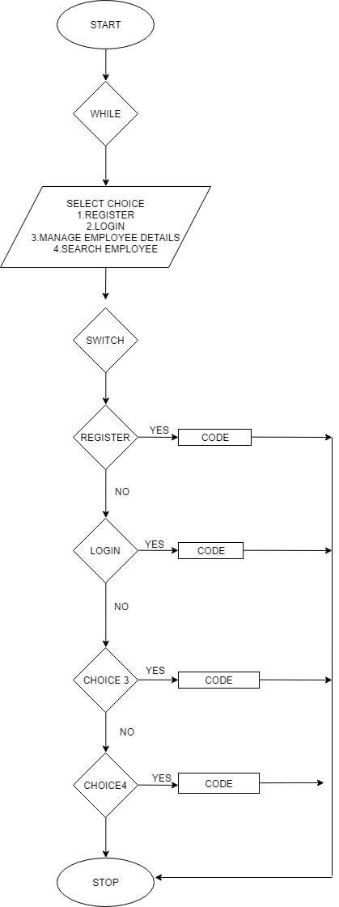



FLOWCHART

Slide 9
MODULES
REGISTER MODULE
LOGIN MODULE
MANAGE EMPLOYEE MODULE
SEARCH MODULE

Slide 10
REGISTER MODULE
This module is used for the new employee where he or she can register themselves and get their login details.

Slide 11

LOGIN MODULE
This module is created for login details of admin and the employee. There are different login details provided and both can login using their respective user id and password.

Slide 12
MANAGE EMPLOYEE MODULE
This module enables admin to add and edit employee records. It is also for viewing the each and every employee details by the admin.

Slide 13
SEARCH MODULE
This module is an added feature in this system which enables to search employee records easily using employee id.

Slide 14
THANK YOU

